Slide 1
Inflation Report August 2019
Demand and output

Slide 2
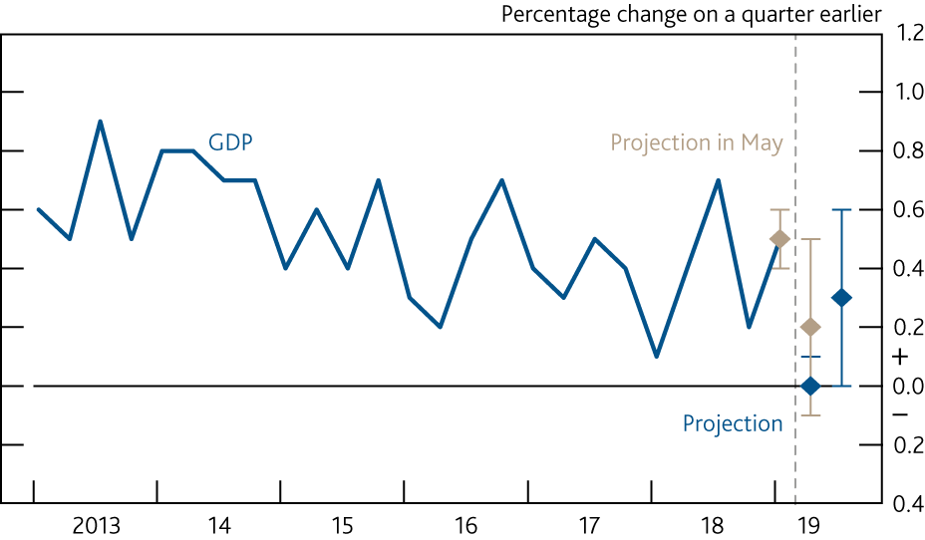
Chart 2.1 GDP is expected to be flat in 2019 Q2
GDP growth and Bank staff’s near-term projection^{(a)}
Sources: ONS and Bank calculations.
(a) Chained-volume measure. GDP is at market prices. The blue diamonds show Bank staff’s projection for the first estimate of GDP growth in 2019 Q2 and 2019 Q3. The bands on either side of the diamonds show uncertainty around those projections based on the out‑of‑sample performance of Bank staff’s best-performing model since 2004, representing ±1 root mean squared error (RMSE). The RMSE of 0.1 percentage points around the 2019 Q2 projection excludes three quarters affected by known erratic factors: the 2010 snow and the 2012 Olympics and Diamond Jubilee. Including those erratic factors, the RMSE for 2019 Q2 rises to 0.2 percentage points. For 2019 Q3, the RMSE of 0.3 percentage points is based on the full evaluation window.

Slide 3
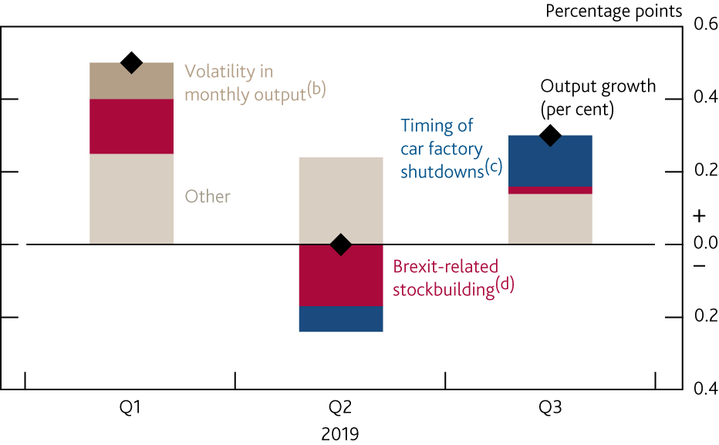
Chart 2.2 The volatility in output has been largely driven by Brexit-related effects
Contributions of idiosyncratic factors to quarterly output growth^{(a)}
Sources: ONS and Bank calculations.
(a) The contributions of idiosyncratic factors are estimated by Bank staff.
(b) GDP fell by 0.3% in December 2018, before rising by 0.5% in January 2019.
(c) Estimates of the impact of car factory shutdowns are based on ONS car production data.
(d) The estimated impact of Brexit-related stockbuilding on Q1 GDP is based on the path of UK manufacturing output in 2019 Q1 relative to other major European economies.

Slide 4
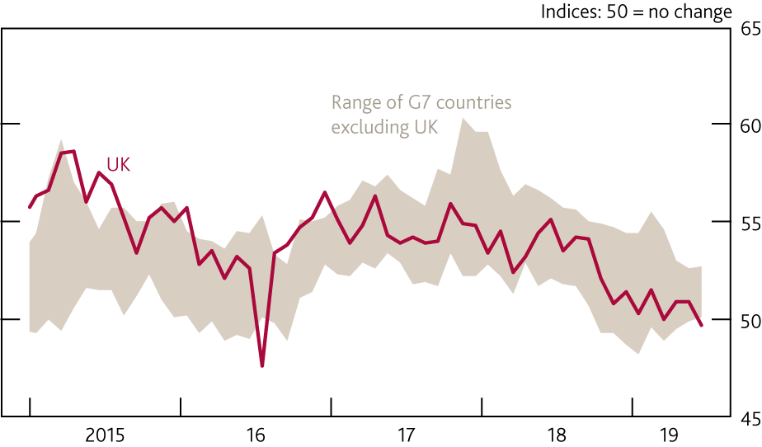
Chart 2.3 Output surveys have weakened across advanced economies
Survey indicators of output growth^{(a)}
Sources: Eikon from Refinitiv, IHS Markit/CIPS and Bank calculations.
(a) Measures of current monthly composite (services and manufacturing) output for France, Germany, Italy, Japan and the United States. IHS Markit/CIPS composite PMI is unavailable for Canada.

Slide 5
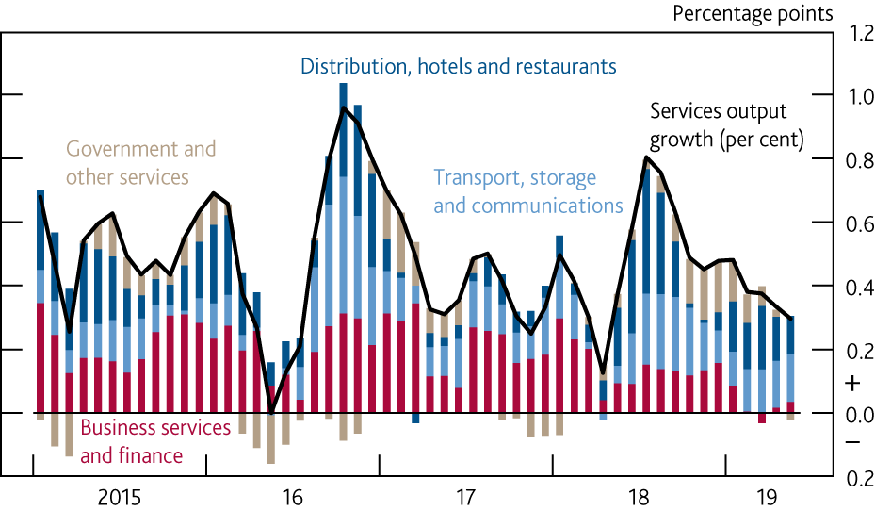
Chart 2.4 Output growth in the business services and finance sector has slowed
Contributions to three-month on three-month output growth in services^{(a)}
(a) Chained-volume measures. Contributions may not sum to the total due to rounding.

Slide 6
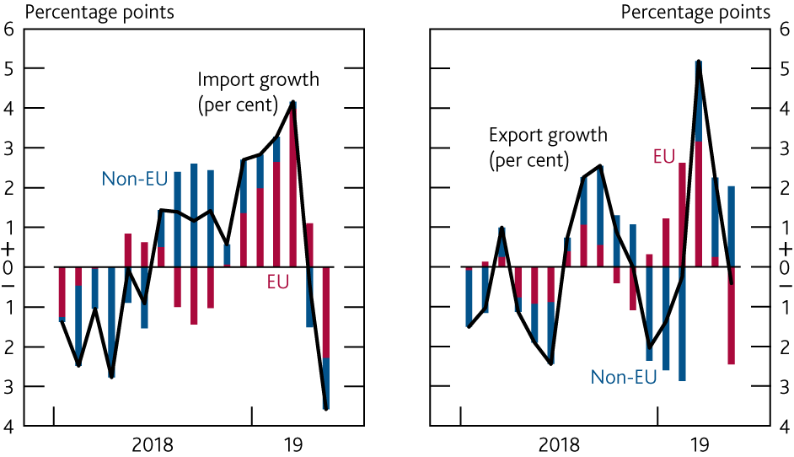
Chart 2.5 Trade with the EU rose in Q1 and fell back in Q2 largely due to stockbuilding
Contributions to three-month on three-month growth in goods imports and exports by area^{(a)}
(a) Chained-volume measures. Goods exports and imports are measured excluding trade in unspecified goods.

Slide 7
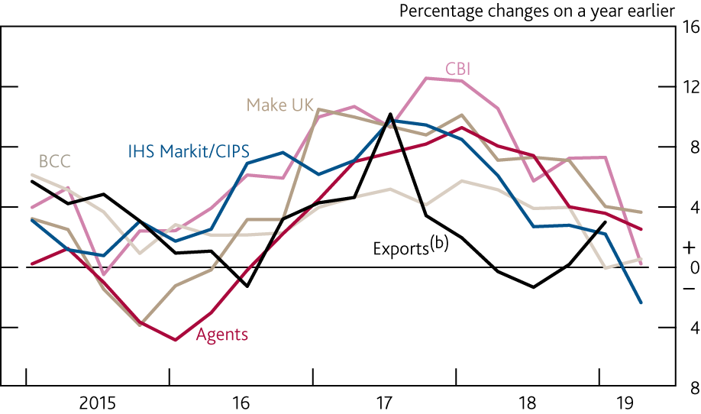
Chart 2.6 Survey indicators of export growth have weakened steadily
UK exports and survey indicators of export growth^{(a)}
Sources: Bank of England, BCC, CBI, IHS Markit/CIPS, Make UK, ONS and Bank calculations.
(a) Survey measures are scaled to match the mean and variance of four‑quarter export growth since 2000. Agents’ measure shows manufacturing companies’ reported annual growth in production for sales to overseas customers over the past three months; last available observation for each quarter. BCC measure is the net percentage balance of companies reporting that export orders and deliveries increased on the quarter; data are not seasonally adjusted. CBI measure is the average of the net percentage balances of manufacturing companies reporting that export orders and deliveries increased on the quarter, and that their present export order books are above normal volumes; the latter series is a quarterly average of monthly data. The Make UK measure is the average of the net percentage balances of manufacturing companies reporting that export orders increased over the past three months and were expected to increase over the next three months; data available since 2000 Q3. The IHS Markit/CIPS measure is the net percentage balance of manufacturing companies reporting that export orders increased this month compared with the previous month; quarterly average of monthly data.
(b) Chained-volume measure, excluding the impact of MTIC fraud.

Slide 8
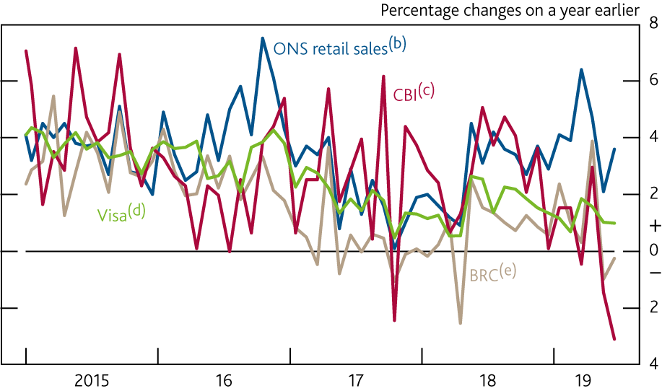
Chart 2.7 Official retail sales data have been stronger than a range of other indicators
Retail sales volumes and survey measures of retail sales^{(a)}
Sources: British Retail Consortium (BRC), CBI, ONS, Visa and Bank calculations.
(a) All survey indicators have been scaled to match the mean and variance of ONS retail sales volume growth since 2000 except the Visa series, which is since 2006.
(b) Chained-volume measure.
(c) Balance of respondents to the CBI distributive trades survey question ‘How do your sales and orders this month compare with a year earlier?’.
(d) Percentage change in Visa total consumer spending on a year ago, deflated by CPI inflation.
(e) Percentage change in total sales. Not seasonally adjusted.

Slide 9
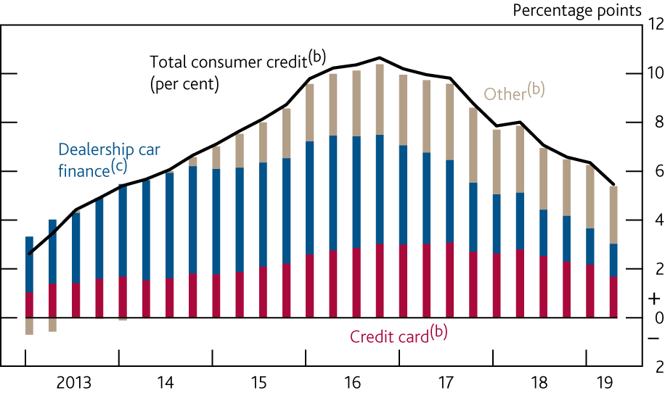
Chart 2.8 Consumer credit growth has continued to slow
Contributions to annual consumer credit growth^{(a)}
Sources: Bank of England, ONS and Bank calculations.
(a) For a description of how growth rates are calculated using credit data see here.
(b) Sterling net lending by UK monetary financial institutions (MFIs) and other lenders to UK individuals (excludes student loans).
(c) Identified dealership car finance lending by UK MFIs and other lenders.

Slide 10
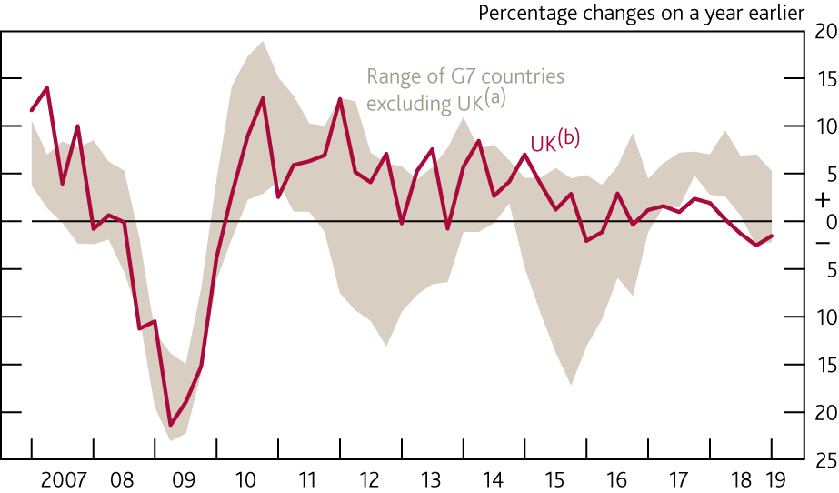
Chart 2.9 UK business investment has been weaker than in other advanced economies
G7 business investment
Sources: Eikon from Refinitiv, Japanese Cabinet Office, OECD, ONS, Oxford Economics, Statistics Canada, US Bureau of Economic Analysis and Bank calculations.
(a) Business investment is not an internationally recognised concept. This swathe includes similar series derived from other countries’ National Accounts. Private sector business investment for Italy. Business investment minus residential structures for Canada. Non‑residential private investment for Japan and the US. Non‑government investment minus dwellings investment for France and Germany.
(b) Chained‑volume measure.

Slide 11
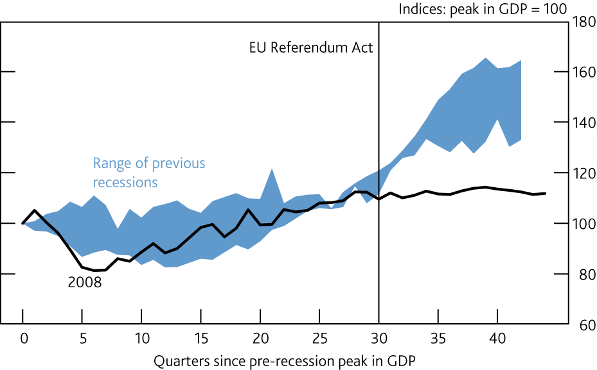
Chart 2.10 Business investment has stalled since the referendum
Business investment after previous recessions^{(a)}
Sources: ONS and Bank calculations.
(a) Chained-volume measure. Recessions are defined as at least two consecutive quarters of negative GDP growth. Previous recessions include those beginning in 1973, 1975, 1980 and 1990. A recovery ends if a second recession occurs in the period shown.

Slide 12
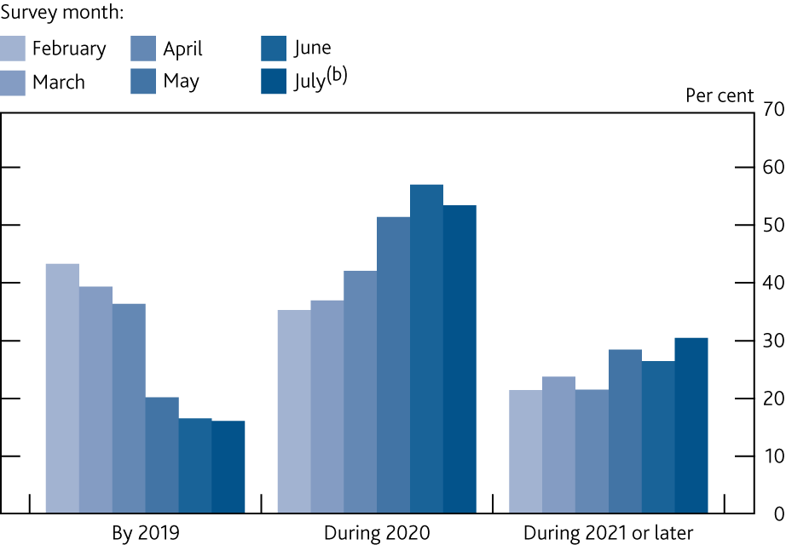
Chart 2.11 More firms now expect Brexit uncertainty to persist at least into next year
Expected date by which Brexit-related uncertainty is expected to be resolved^{(a)}
Source: DMP Survey.
(a) Question: ‘When do you think it is most likely that Brexit-related uncertainty facing your business will be resolved?’. Data are for the percentages of businesses that state that they are affected by Brexit-related uncertainty. The DMP consists of around 8,000 businesses with around 3,000 responses received to the survey each month.
(b) Survey taken between 5–19 July.

Slide 13
Tables

Slide 14
Table 2.A Consumption growth was resilient in 2019 Q1
Expenditure components of demand^{(a)}
(a) Chained-volume measures unless otherwise stated.
(b) Includes non-profit institutions serving households (NPISH).
(c) Investment data take account of the transfer of nuclear reactors from the public corporation sector to central government in 2005 Q2.
(d) Excludes the alignment adjustment.
(e) Percentage point contributions to quarterly growth of real GDP.
(f) Includes acquisitions less disposals of valuables. The pickup in 2019 Q1 can largely be accounted for by an increase in the imports of valuables, including non-monetary gold. Movements in non-monetary gold do not affect headline GDP as they are recorded as equal and offsetting impacts on gross capital formation and net trade.
(g) Excluding the impact of missing trader intra-community (MTIC) fraud.

Slide 15
Table 2.B Monitoring the MPC’s key judgements

Slide 16
Box 2
Agents’ update on business conditions

Slide 17
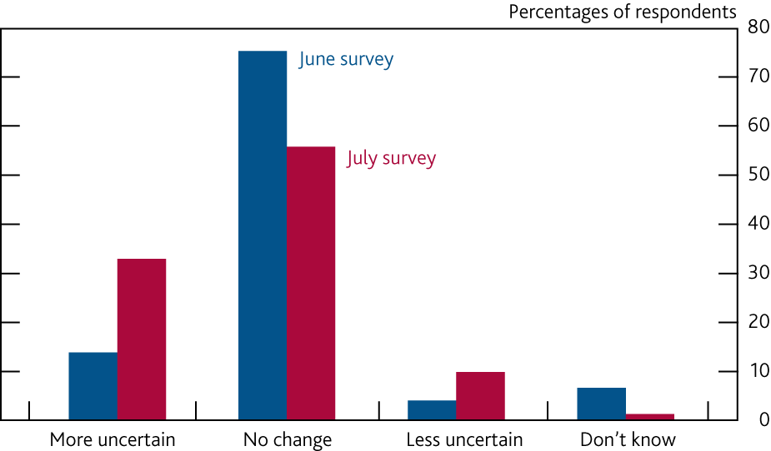
Chart A Companies are more uncertain about the outlook
Change in uncertainty since the Brexit deadline extension^{(a)}
(a) Companies were asked ‘Are you more or less uncertain about the economic outlook now than you were prior to the extension of the EU withdrawal deadline to the end of October 2019?’.

Slide 18
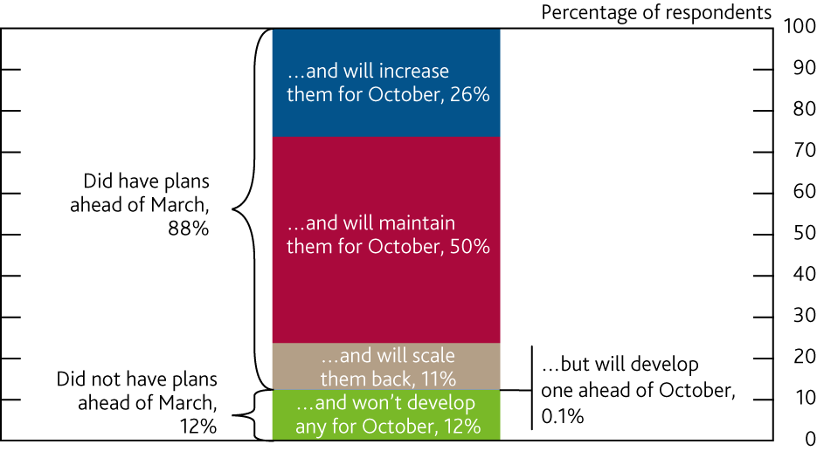
Chart B Most companies have contingency plans for Brexit
Brexit contingency plans^{(a)}
(a) Companies were asked ‘How has the Brexit extension affected your contingency plans?’. Bars may not sum to 100 due to rounding.

Slide 19
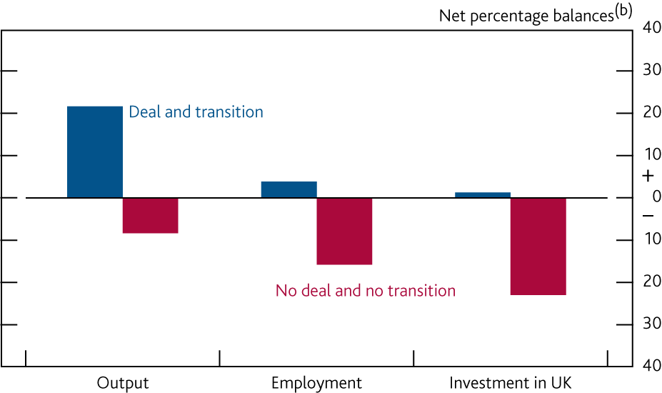
Chart C Companies expect output, employment and investment to be much lower in a no-deal Brexit
Expectations for the effect of Brexit^{(a)}
(a) Companies were asked ‘Relative to the last 12 months, what is your expectation for the following aspects of your business over the next year in each scenario: (a) a deal and transition period and (b) no deal and no transition period?’. For each relevant business factor, respondents were asked to choose between ‘Fall greater than 10%’; ‘-10 to -2%’; ‘Little change’; ‘+2 to +10%’; and ‘Rise greater than 10%’.
(b) Net percentage balances of companies reporting increases or declines in each factor, weighted by employment. Half weight was given to the ±2%–10% response and full weight was given to those that responded ‘Rise/fall greater than 10%’.

Slide 20
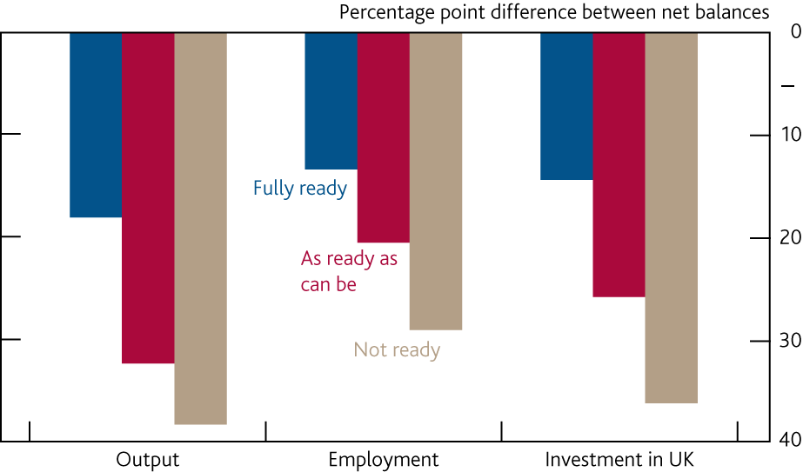
Chart D Firms that are less ready for a no-deal Brexit expect a larger negative economic impact
Net balances under a no-deal scenario minus that under a deal and transition^{(a)}
(a) The net percentage balance under a no-deal Brexit scenario minus that under a deal scenario. The more negative the figure, the larger the perceived detrimental impact of a no-deal Brexit relative to a deal scenario. The method for calculating the net balance is set out in footnote (b) of Chart C.

Slide 21
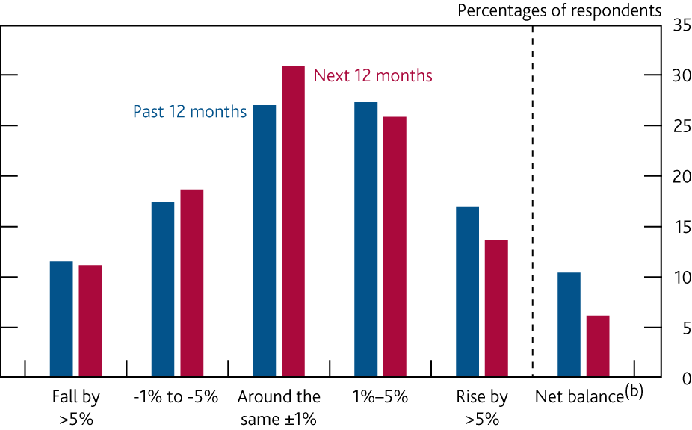
Chart E Companies expect to increase staffing over the next year
Changes in staff numbers^{(a)}
(a) Companies were asked ‘How have staff numbers changed over the past 12 months; and how do you expect them to change going forwards (over the next 12 months)?’. Respondents were asked to choose between the five options shown in the chart.
(b) Net percentage balance of companies reporting increases or declines in staffing, weighted by employment. Half weight was given to the rise/fall 1%–5% response and full weight was given to those that responded rise/fall >5%.

Slide 22
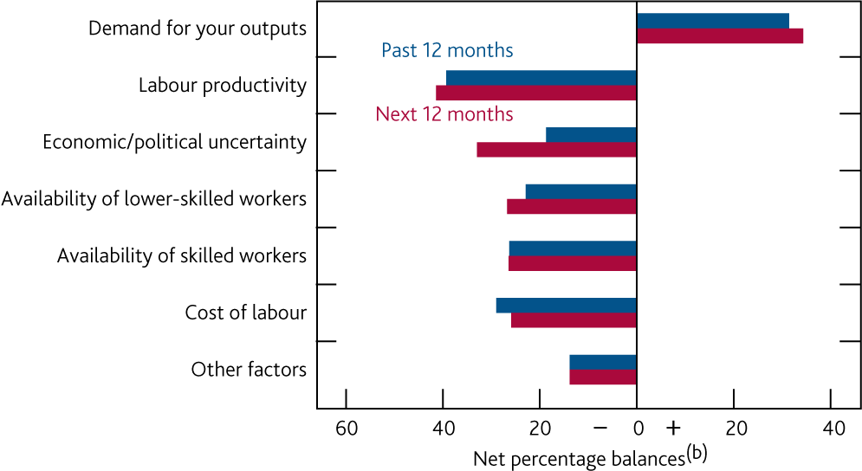
Chart F Increased labour productivity and uncertainty are reported to reduce employment levels
Reasons for changing staff numbers^{(a)}
(a) Companies were asked ‘How have changes in the following factors affected employment levels over the past 12 months and how do you expect them to affect employment over the next 12 months?’. Contacts were asked to choose between: ‘Reduce’; ‘No impact’; or ‘Increase’.
(b) Net percentage balance of companies reporting that each factor was increasing or reducing employment levels.

Slide 23
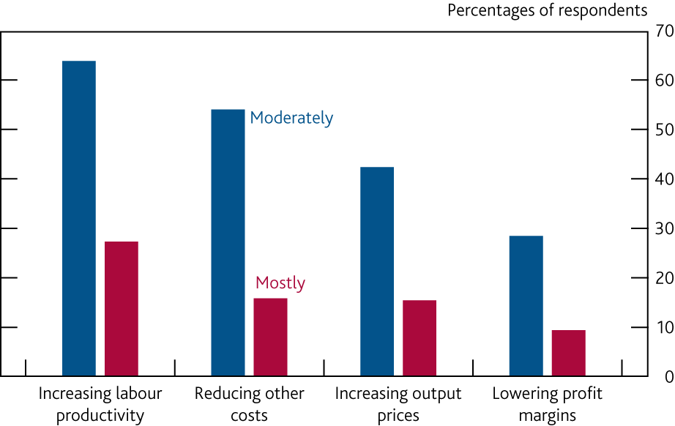
Chart G Firms expect increased productivity to help cover the cost of wage growth
Measures to cover the cost of rises in wages per head^{(a)}
(a) Companies were asked ‘If wages per head are growing, how do you expect to cover that cost?’. For each factor, respondents were asked to choose between ‘Not at all’; ‘Moderately’; and ‘Mostly’.

Slide 24
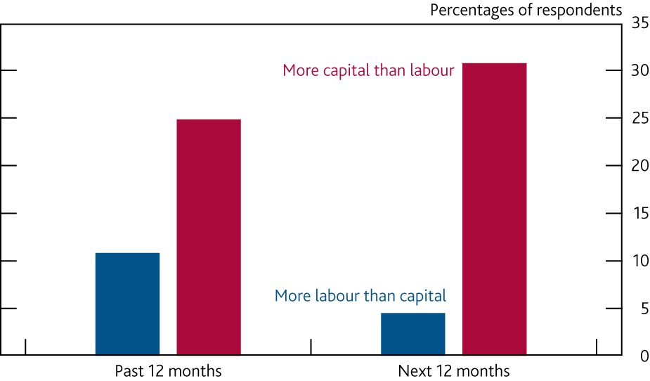
Chart H More firms expect to shift towards using more capital than towards more labour
Changes in the capital to labour mix^{(a)}
(a) Companies were asked ‘Have you changed the balance of labour and capital inputs over the past 12 months; and do you expect it to change over the next 12 months?’. For each period, respondents were asked to choose between ‘More labour than capital’; ‘Little change in balance’; and ‘More capital than labour’.

Slide 25
Box 3
Households’ expectations: evidence from the latest NMG survey

Slide 26
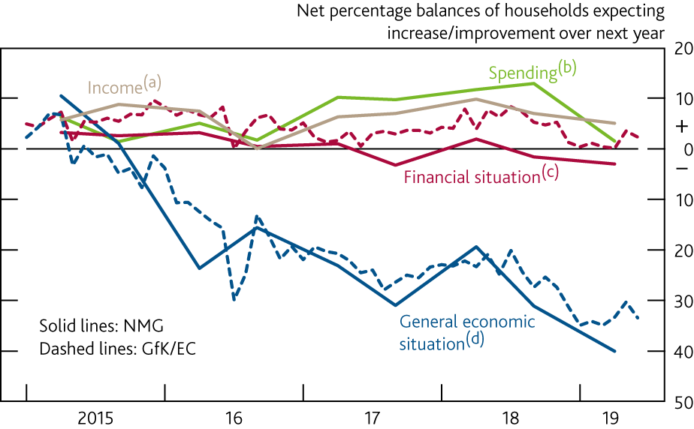
Chart A Households’ expectations for their own financial situation remained stable
Households’ expectations in the NMG and GfK/EC surveys
Sources: GfK/EC, NMG Consulting and Bank calculations.
(a) Question: ‘Over the next 12 months, how do you expect your total household income (before anything is deducted for tax, National Insurance, pension schemes etc) to change?’.
(b) Question: ‘How do you expect your household to change its spending over the next 12 months? Please exclude money put into savings and repayment of bank loans’.
(c) Question: ‘How do you expect the financial position of your household to change over the next 12 months?’.
(d) Question: ‘How do you expect the general economic situation of this country to develop over the next 12 months?’.

Slide 27
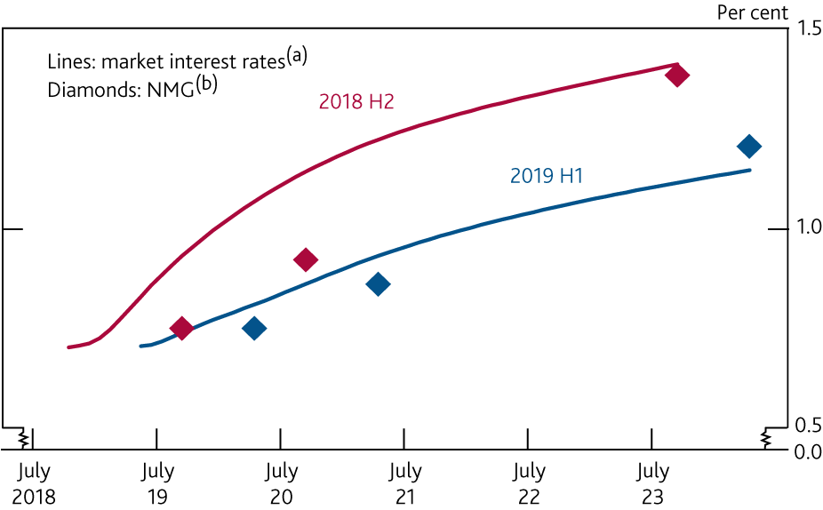
Chart B Households continue to expect a limited and gradual increase in interest rates over the next two years
Expectations for interest rates
Sources: Bloomberg Finance L.P., NMG Consulting and Bank calculations.
(a) Estimated using instantaneous forward overnight index swap rates over the period of the respective NMG survey.
(b) Question: ‘The level of interest rates set by the Bank of England (Bank Rate) is currently 0.75%. At what level do you expect that interest rate to be in each of the following time periods (1 year, 2 years, 5 years)?’.

